Slide 1
Capstone III Presentation
Project: Analysis of Used Car Data
Presented By: Dalton Clark

Slide 2
The Dataset
The dataset used for the analysis contains information on used cars from India ranging from 1994 to 2020. For original dataset click here
There are 7907 records across 17 fields. The fields that are relevant to this analysis are:
Km Driven
Year
Selling Price
Seller Type

Slide 3
Research Questions
For my analysis I developed two questions that I want to answer
Is there a correlation between the year a vehicle was made and the number of miles on the car
Is there a significant difference in the selling price of a vehicle if it is sold by an individual or a dealer?

Slide 4
Hypotheses
The two hypotheses that I have for my analysis are
There is a correlation between the year a vehicle was made and the number of miles on the vehicle
There is a significant difference between the selling price of a vehicle based on if it was sold by an individual or a dealer

Slide 5
How The hypotheses Will Be Tested
For the first hypothesis, a scatterplot will be used to show the correlation between the year of the vehicle and the miles on the vehicles.
For the second hypothesis, a t-test will be conducted to show if there is a significant difference between the sale price of a vehicle based on the seller.

Slide 6
Hypothesis 1
Before testing, I converted kilometers to miles under the field name miles driven.
Next, I created a scatterplot to visualize the correlation between the two variables.
I also calculated the correlation coefficient and p-value. The correlation coefficient is a value between -1 and 1, -1 being a strong negative correlation and 1 being a strong positive correlation. The smaller the p-value the greater the significance.

Slide 7
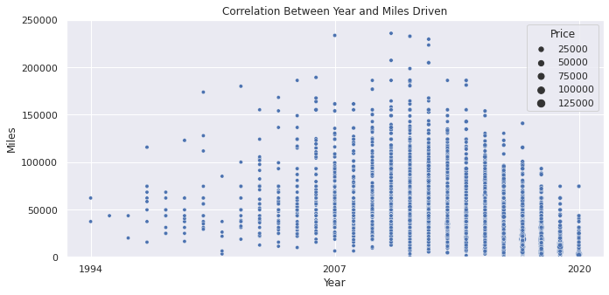
Hypothesis 1 Testing Results
While the scatterplot shows a relatively moderate correlation, the correlation coefficient and p-value point towards a stronger correlation between miles driven and year made.
Correlation Coefficient: - 0.42
P-Value: > 0.05

Slide 8
Hypothesis 2
For hypothesis 2, an independent samples t-test was used to test if there is a significant difference in selling price if the seller is a dealer or an individual
A bar graph showing the mean price of the seller groups was made to visualize the difference in average price
Before conducting the t-test, a new field named Price is created, converting the selling price field from INR to USD.

Slide 9
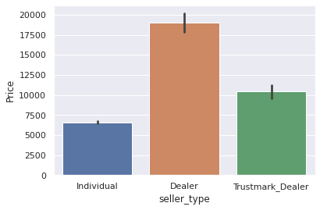
Hypothesis 2 Testing Results
The smaller the p-value, the greater the statistical significance of the observed difference. The p value for the observed difference of the t-test is very small at 4.09 e-305 with a 95% level of confidence, indicating a significant difference. Therefore, there is sufficient evidence to reject the null hypothesis
Mean Prices
Individual: $6,600
Dealer: $18,978

Slide 10
Testing Summary
Hypothesis 1 is supported. There is a relatively strong negative correlation between the year and the miles a vehicle has. The older the vehicle, the more miles it will have.
Hypothesis 2 is rejected. There is strong statistical evidence that the selling price of a vehicle is lower when sold by an individual than a dealer.
Click for Colab Notebook
Click for Original Dataset

Slide 11
How Will The Findings Be Used?
Used car lots will be interested in knowing if older vehicles come with more miles.
They also will want to know if the prices of vehicles are significantly different if purchased from a dealer or an individual.
Knowing this will be helpful in decreasing cost when purchasing vehicles for the lot.

